Slide 1
UMKC Strategic Marketing & Communications
2016
Faculty Senate Update,
December 2016

Slide 2
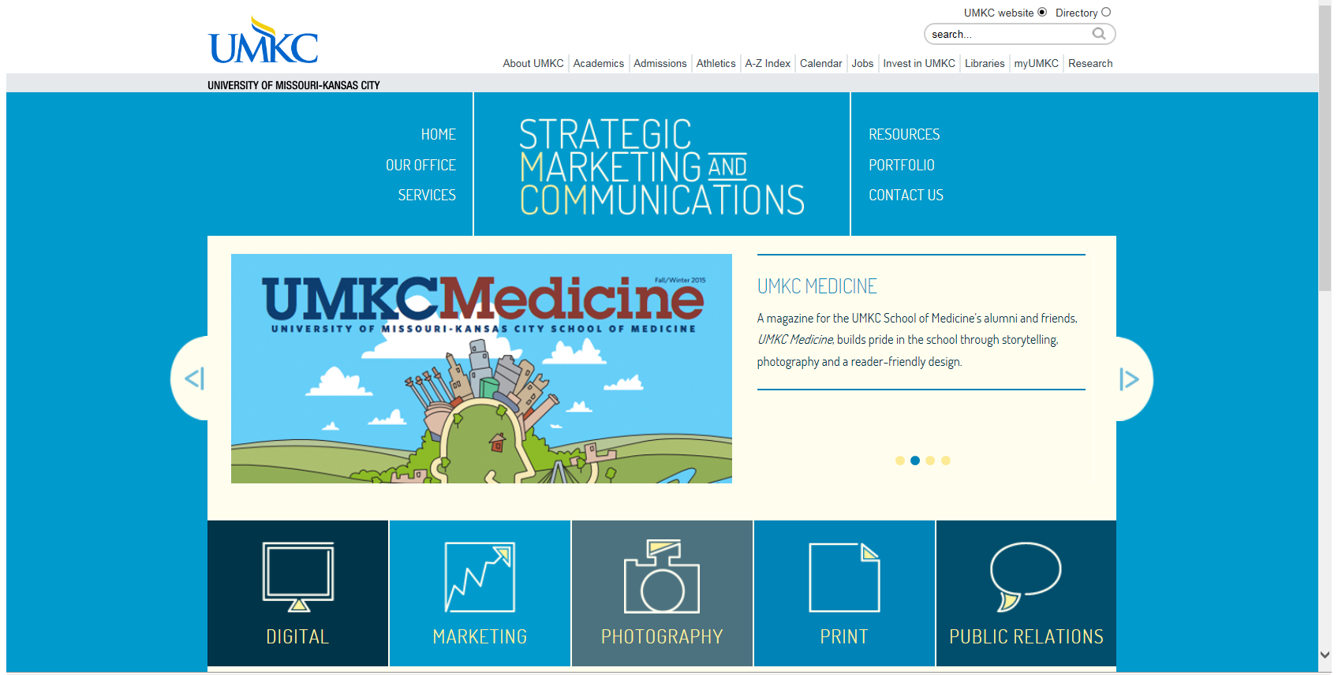
Overview of MCOM
Notes:
www.umkc.edu/mcom

Slide 3
CREATIVE -- By The Numbers
Notes:
Areas of focus: Time spent supporting different areas of campus
35% Academic support (projects for the academic units, provost’s office, academic affairs, research)
35% Student success (admissions, student affairs, marketing campaign, athletics)
20% Fund and friend raising (advancement, foundation, alumni, KCUR)
10% University-wide (mcom, hr, finance and administration, etc.)

Slide 4
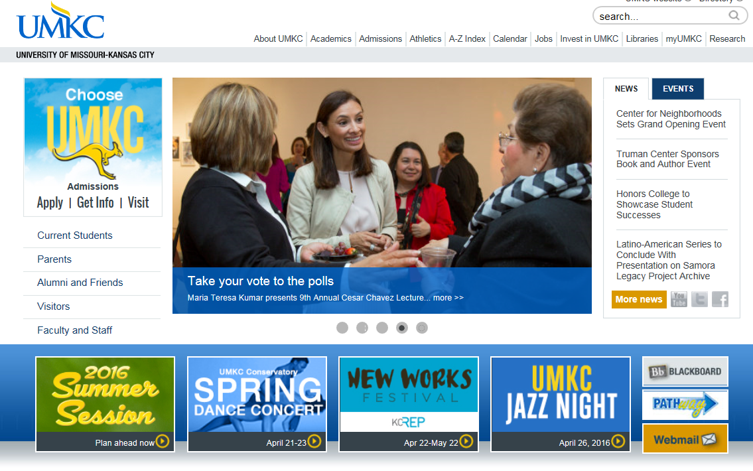
WEB and DIGITAL -- By The Numbers
UMKC Home page
8.5 million views in FY2016
700,000 views a month

Slide 5
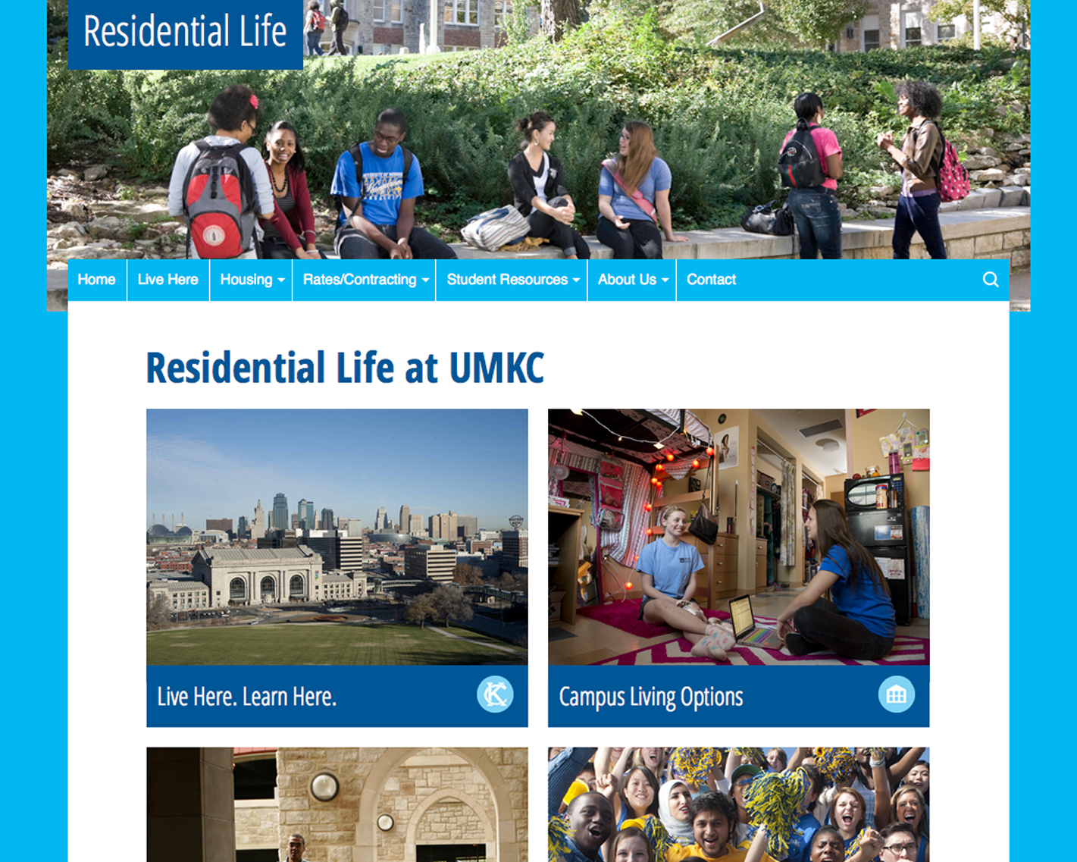
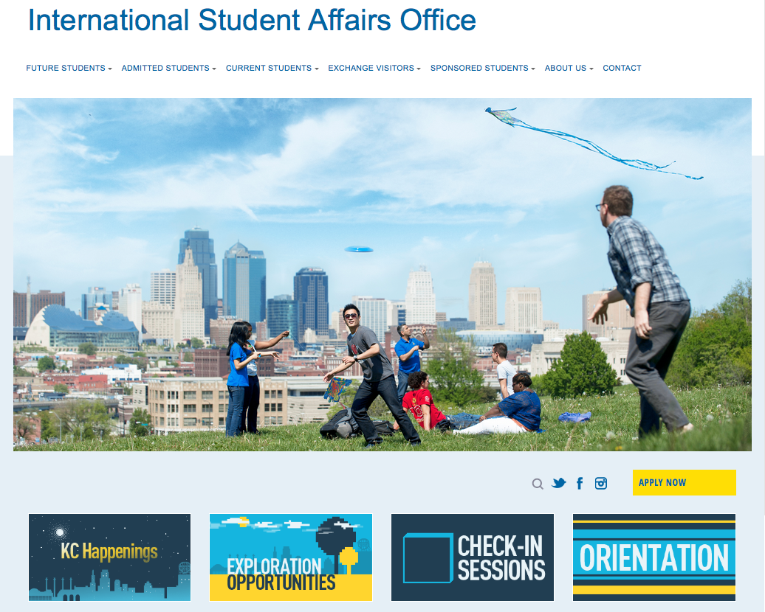
WEB and DIGITAL -- By The Numbers
Residential Life website - ^112%
ISAO website - ^15%

Slide 6
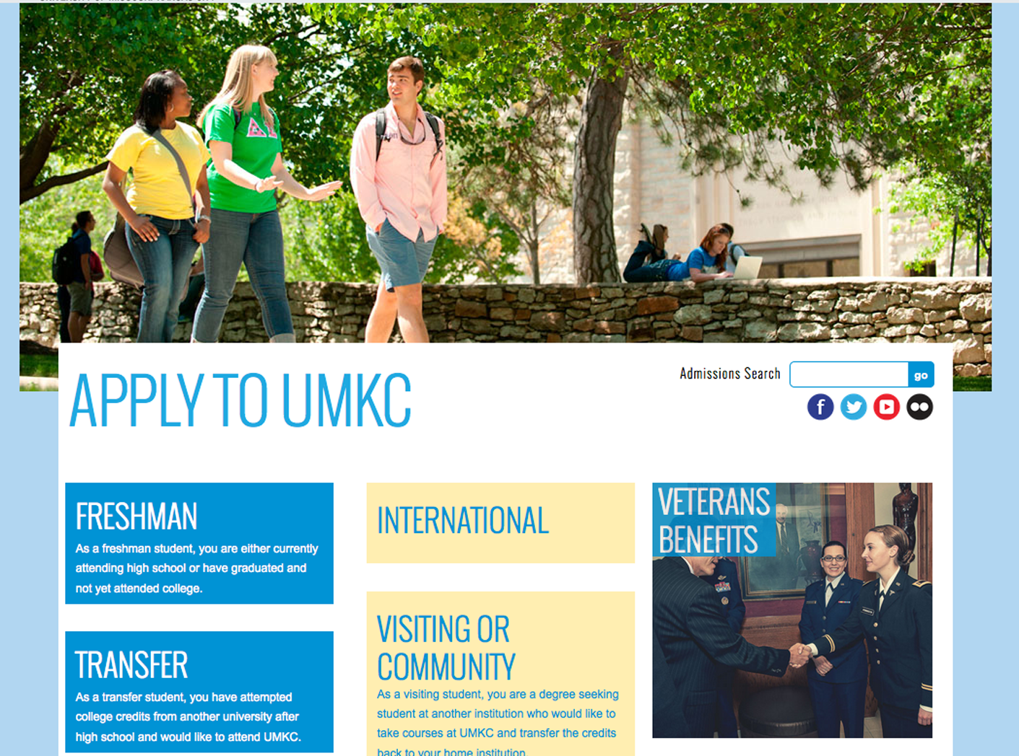
WEB and DIGITAL -- By The Numbers
Apply website
^30%
FTC enrollment –FS16
^18%

Slide 7
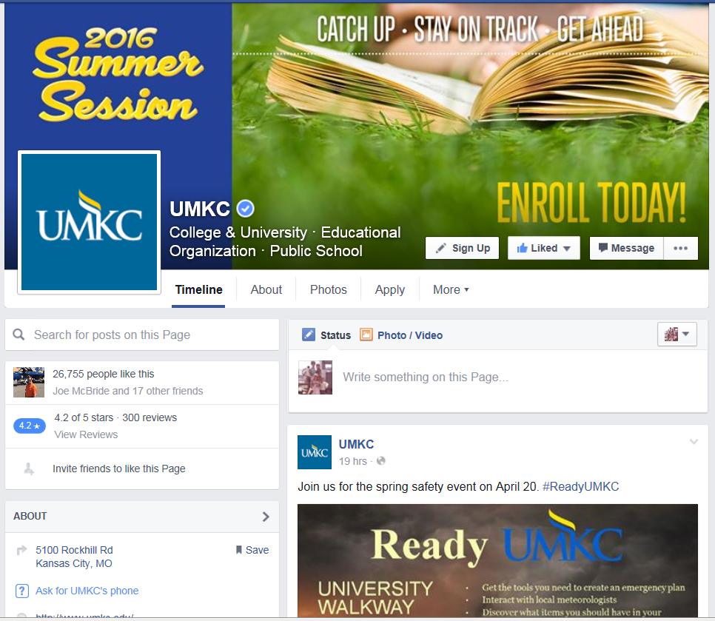
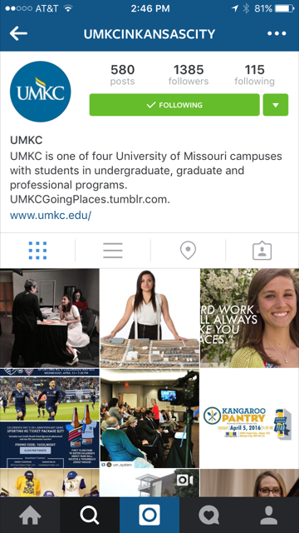
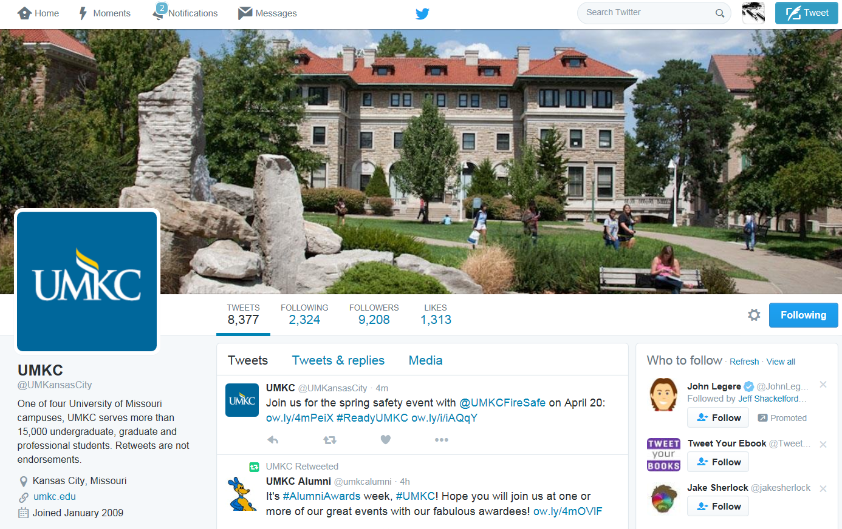
Social media – by the numbers
^26%
26,755
followers
^384%
1,385
followers
^69%
9,208
followers

Slide 8



MARKETING -- GOING PLACES & MORE
Integrated marketing – Primarily digital (targeting and retargeting, paid search, SEO/SEM, paid social) but also print, radio, spot TV, paid social and paid video
Marketing partnerships, including with Sporting KC, area school districts, Hospital Hill run and KC marathon, etc.
Signage (billboards and some campus/community signage)
Going places home page views ^21% FS ’16

Slide 9
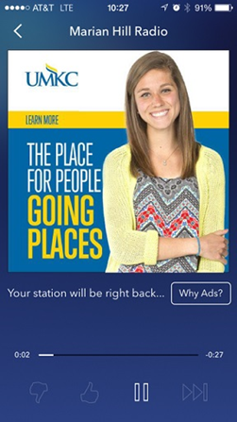
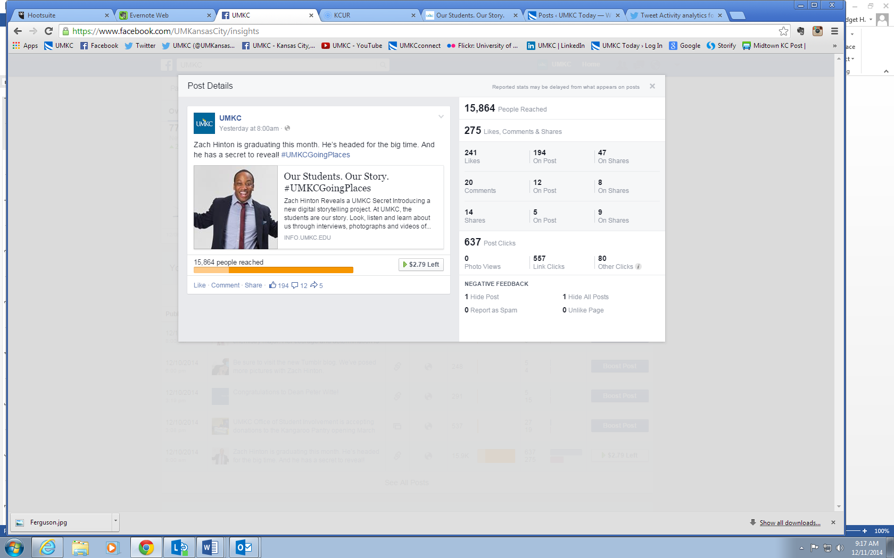
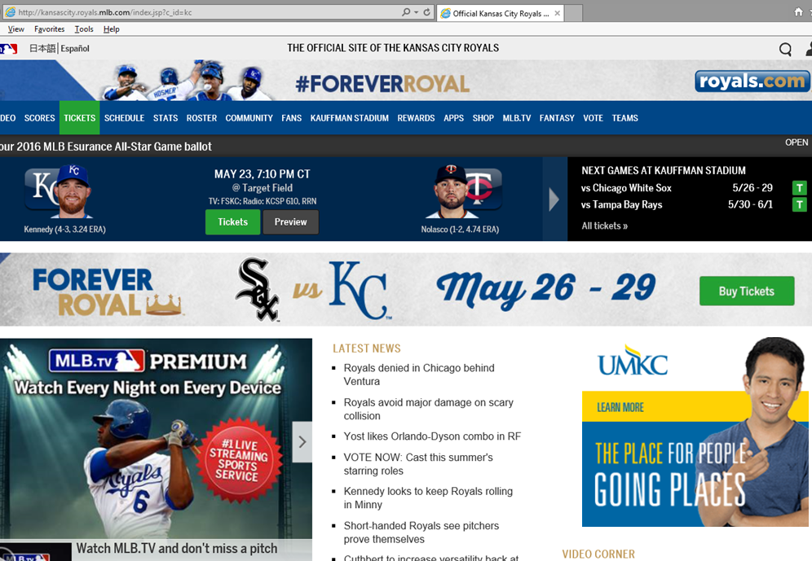
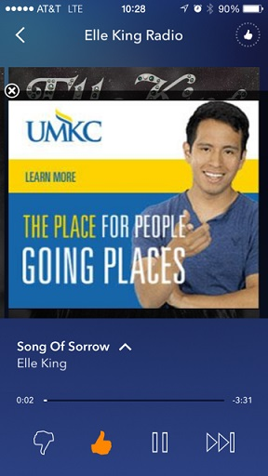
Marketing
Facebook conversions
^58%
Paid search conversions
^48%
Video completes ^48%

Slide 10
PR -- By The Numbers (FY2016)
1,025
Total news media placements
194
Media requests received
978+
Photos posted in galleries, social media or other
417
News stories posted to UMatters
329
News stories posted to other UMKC sites

Slide 11

MarketING, PR, CREATIVE services, SOCIAL MEDIA and MANY of our WEB SERVICES...
Campus clients DO pay hard costs for projects (e.g. printing costs for a brochure, or T-shirt, etc.)
We DO charge **below-market** for some specialty areas: For example, photography, some specific web services that we couldn’t afford to provide otherwise.

Slide 12
GETTING UMKC News PUBLISHED
It all starts with a phone call, email or in-person contact with us – or when we hear things while we’re out and about on campus and contact YOU.
We also have regular meetings with all AUs, which frequently yield story ideas.
Advance notice is incredibly helpful, but we’ll do our best to help out even in late-breaking situations, if we are able.
Opportunities to be published in “owned” not just “earned” channels.

Slide 13
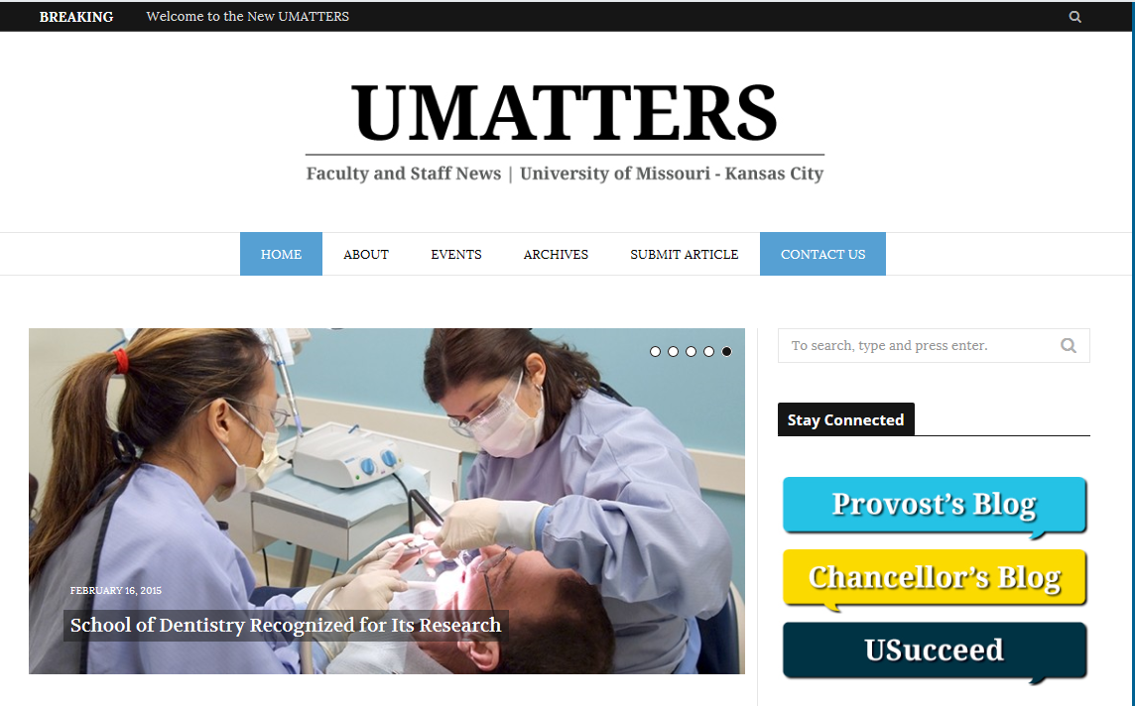
MORE Ways to share your story
Send us a story tip through UMatters...
Publishes weekly
Typically includes 15-20 original stories per week ranging from faculty research and awards to campus events, HR news and more
Notes:
http://info.umkc.edu/umatters/

Slide 14
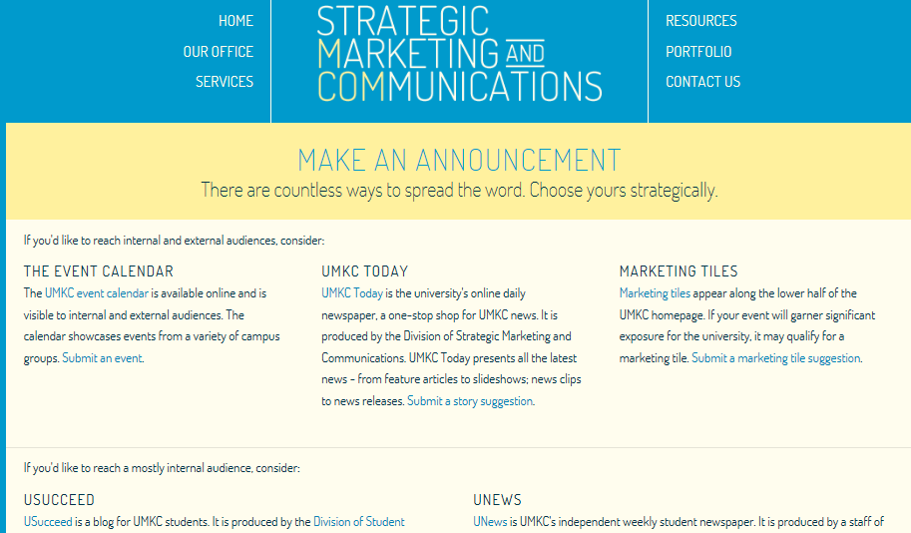
MORE Ways to share your story
OR through the MCom website, under Resources tab.
www.umkc.educ/mcom
Notes:
http://www.umkc.edu/mcom/resources/make_announcements.cfm

Slide 15
General CRITERIA for Media PITCHES
The “NEW” in News
Timing of your news/event
Firsts
Impressive statistics, investment or impact
Demonstrates UMKC strategic goals in compelling way
Emotional impact
Good visuals
Tied to current events
Relevance
Audience fit. Who are we media trying to reach through our news?
If not a fit with the above, we’ll offer many alternative places to get exposure ...

Slide 16
Outlets for faculty/UMKC news
Besides local, regional and national media (print, digital and broadcast)
  UMKC.edu and UMKC Today
  UMatters
  Your own AU’s website or Four Winds screens
  UMKC and other UMKC Facebook, Twitter and other social media
  Our UMKC-produced magazines, including Explore, Perspectives, UMKCMedicine, Res Ipsa and Bloch Magazine
  eRoos and other alumni publications/newsletters
  Other: Blogs, higher ed publications, trade and professional journals, local web and media partners, etc.
  Partner social media sites, newsletters and blogs
  Faculty and staff newsletters within units (e.g. A&S, SCE, Bloch, etc)
  Etc!!

Slide 17
More about our PR services
In addition to writing news stories, media releases or social media:
  We can provide feedback on how to increase appeal of your story for media (which includes use of AP Style)
  We can create a customized media pitch list based on topic area using a media database
  We can provide media training – how to sound and look your best on TV/radio or provide a “practice interview” for print media
  We can identify opportunities that may make your story more appealing to newspaper, TV, radio
  We can identify news or community partners who can “like,” “retweet” or otherwise promote social media posts.
  We can provide social media coverage for events, i.e. “live tweet”
  And, when merited, we can create a full-blown communications plan to gain coverage for UMKC news

Slide 18
YOUR MCOM CONNECTIONS
A&S
RM: Kim West (x1574)
PR: John Martellaro (x1592) and Bridget Koan (x6678)
In-unit: Marion During (x6108)
Biological Sciences
RM: Hallie Spencer (x5250)
PR: Stacy Downs (x1441)
Bloch
RM: Sarah Morris (x1023)
PR: Wandra Green (x1601)
In-unit: Megan Cooper (x1373)
Computing and Engineering
RM: Kim West (x1574)
PR: Kelsey Haynes (x1596)
In-unit: Sara Vogt (x5223)
Conservatory
RM: Kady McMaster (x5705)
PR: Bridget Koan (x6678)
In-unit: Dana Self (x2949)
Dentistry
RM: Sarah Morris (x1023)
PR: Stacy Downs (x1441)
In-unit: Bill Marse (x2104)
Education
RM: Sarah Morris (x1023)
PR: John Martellaro (x1592)
In-unit: Barbara Schaaf-Petty (x1299)
Honors College
RM: Hallie Spencer (x5250)
PR: Wandra Green (x1601)
Academic Affairs/Graduate Studies
RM: Kim West (x1574)
PR: John Martellaro (x1592)
Law
RM: Kady McMaster (x5705)
PR: John Martellaro (x1592)
In-unit: Alyssa Baker (x2393)
Libraries
RM: Hallie Spencer (x5250)
PR: John Martellaro (x1592)
Nursing and Health Studies
RM: Kady McMaster (x5705)
PR: Stacy Downs (x1441)
In-unit: Rachel Ingalls (x1723)
Pharmacy
RM: Sarah Morris (x1023)
PR: Stacy Downs (x1441)
In-unit: Bryce Puntenney (x1607)
Research
RM: Hallie Spencer (x5250)
PR: John Martellaro (x1592)
University College
RM: Kim West (x1574)
PR: John Martellaro (x1592)
UMKC Online
RM: Kim West (x1574)
PR: John Martellaro (x1592), Stacy Downs (x1441)
Note: Wandra Green will be retiring in February 2017, with replacement TBA. John Martellaro would be the backup.

Slide 19
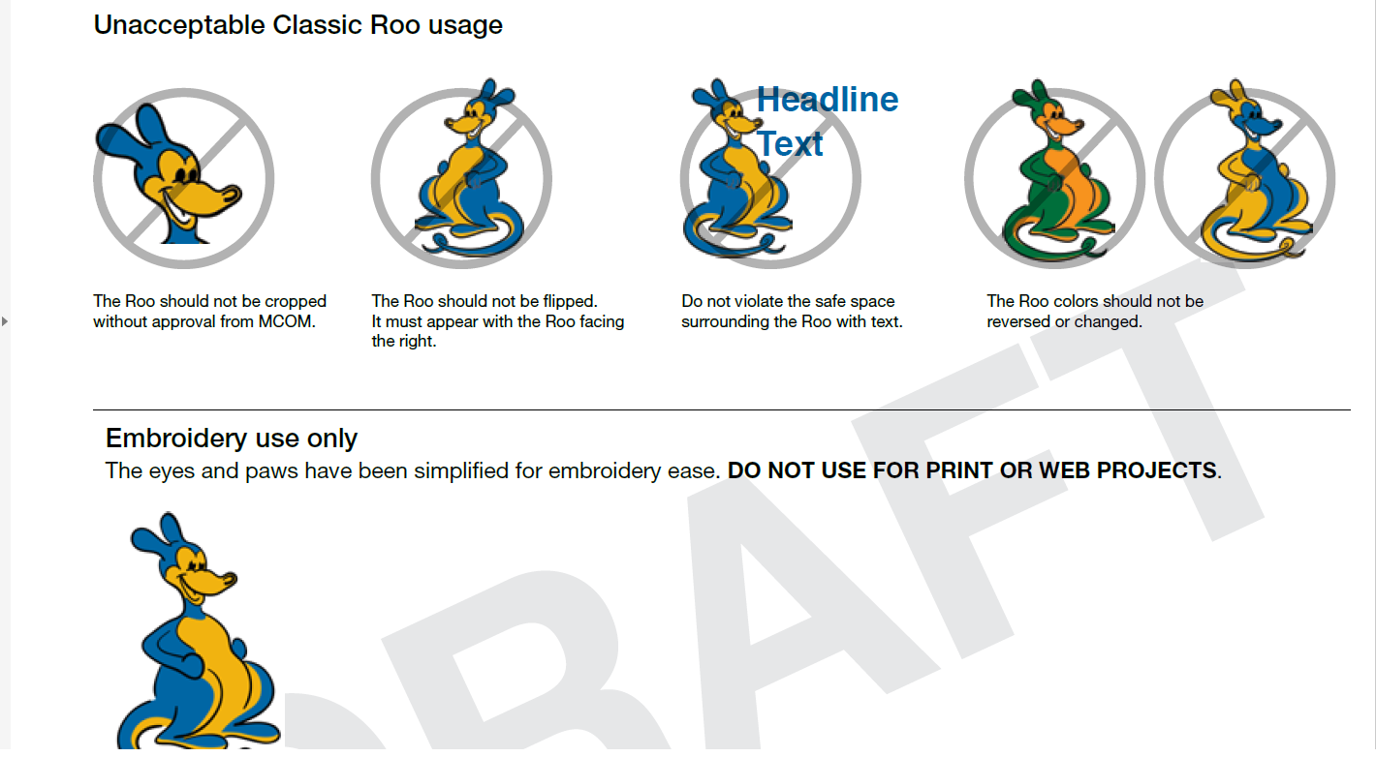
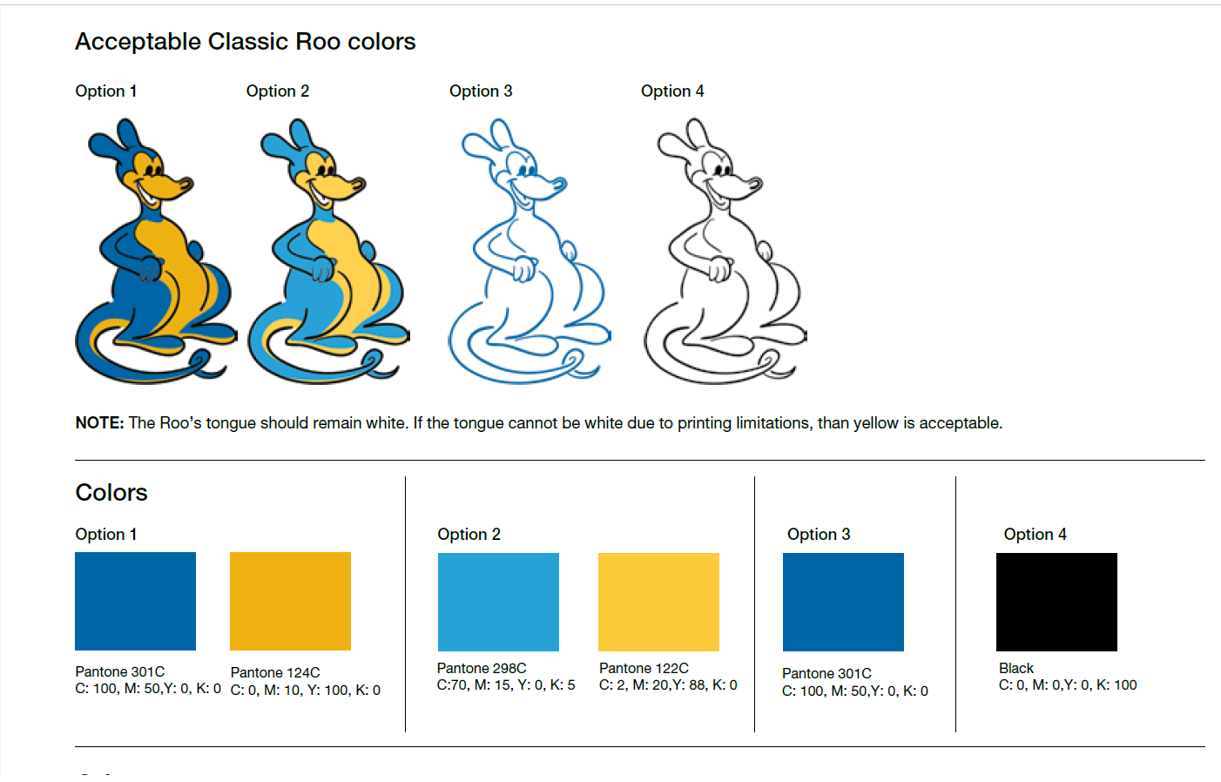
UPDATED UMKC BRAND POLICY
New brand standards guide online
Campus roll out and workshops to come
Brand standards committee meets quarterly, or more often as needed
Notes:
http://www.umkc.edu/mcom/resources/standards_manual.cfm

Slide 20
STRENGTHENING THE UMKC BRAND
We STRONGLY ADVOCATE for brand consistency when using all our UMKC-affiliated brands and marks, from our official UMKC logo to our UMKC Roo logos. That’s what makes a brand strong, easily identifiable and credible with the public.
When branded items are being produced, they need to be vetted by our brand standards team: Kim West (ext. 1574) and Terry Raumschuh (ext. 5388). Athletic brands vetted by Tim Riva (ext. 2789)
We STRONGLY ENCOURAGE our campus academic units and administrative units to use our official UMKC Roos marks and other UMKC brand elements, according to brand guidelines.
We are ready to supply guidance and ideas if you have a brand challenge that you need help with or you have questions about our brand policies. While we’re striving for consistency, we also recognize the need for flexibility.
Notes:
The only caveat: We don’t allow UMKC Roo or logo on fundraising products.

Slide 21
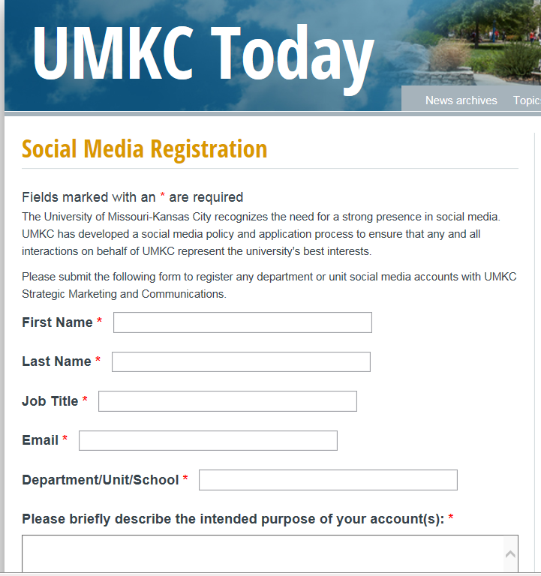
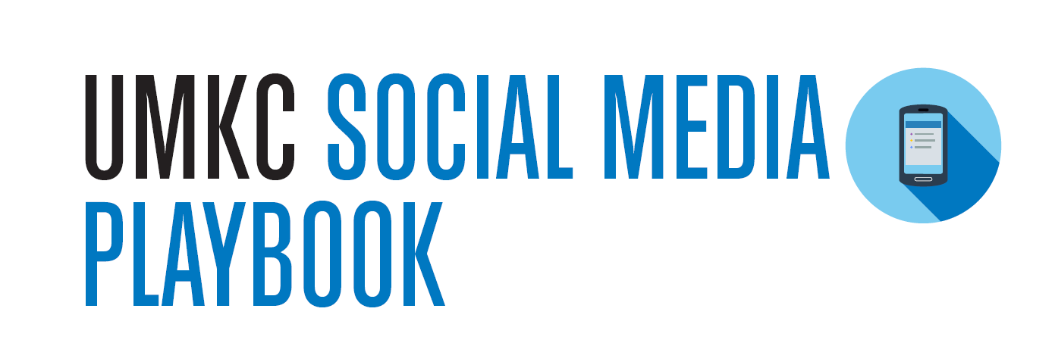

NEW Social Media POLICY
Social media policy
Social media playbook
Free training and backup provided
Notes:
http://www.umkc.edu/mcom/resources/social.cfm

Slide 22
Questions?
Thank you for your time!

